Slide 2
Autism in the Workforce: Keys to a Successful Transition
Teresa Grenawalt, PhD, CRC
The University of Alabama
E-mail: tagrenawalt@ua.edu
Presented on: April 21, 2022

Slide 3
Learning Objectives
Understand the variety and unique work needs of individuals with Autism
Have practical work accommodation strategies to explore with consumers and employers
Understand the employer and co-worker perspectives when Autism is accommodated in the workplace
Continue the dialogue about neurodiversity in the workplace

Slide 4
Overview
Autism and Employment
A Case Study: Hart-Schaffner Marx (HSM) and Autism Workforce Collaboration
Findings—the employer and employee’s perspective
Implications for employers and practitioners
Notes:
This presentation will provide information for a variety of audiences. While there are clear implications for employers and rehabilitation professionals, parents and caregivers will have some insight into how young adults with autism may be perceived in the workplace, and how workplace preparation can assist with destigmatizing autistic coworkers.

Slide 5
Autism Spectrum Disorder
Autism is a neurological developmental disability with an estimated prevalence of one to two percent of the American and worldwide population.
The diversity of the disability means that each person's individual experience of autism and needs for supports and services can vary widely.
For this reason, the clinical diagnosis in the American Psychiatric Association's DSM-5 uses the term autism spectrum disorder.
However, all children, youth, and adults on the autism spectrum experience a common atypical neurological profile with several key traits.
They may have atypical language and communication, social interaction, motor coordination and sensory processing, and executive functioning.

Slide 6
Autism and Employment
>50%
Unemployed and out of college
15%
Employed Rate
$160
Median weekly pay
~ 50%
25-year-olds never had a paying job
Notes:
More than half of young adults with autism remain unemployed and unenrolled in higher education in the two years after high school. This is a lower rate than that of young adults in other disability categories, including learning disabilities, intellectual disability or speech-language impairment.
Employment rates are as low as 15% compared to 65% for people without disabilities.
Of the nearly 18,000 people with autism who used state-funded vocational rehabilitation programs in 2014, only 60 percent left the program with a job. Of these, 80 percent worked part-time at a median weekly rate of $160, putting them well below the poverty level.
Nearly half of 25-year-olds with autism have never held a paying job.
Americans on the autism spectrum experience substantial challenges to attaining competitive integrated employment opportunities that match their interests, gifts, and talents. They experience substantial unemployment and underemployment, according to the research literature. Adults and youth on the autism spectrum also experience barriers to completing postsecondary education and training opportunities, accessing healthcare, and attaining integrating community living.
Employers have increasingly focused on expanding efforts to improve access to employment for job candidates on the autism spectrum to tap their diverse talents. Many large and small employers have adjusted their recruitment, hiring, and onboarding policies and practices to increase access for this population.

Slide 7
Autism and Employment
Willing and capable workforce
Benefits of hiring employees with Autism:
Reliability
Trustworthiness
High attendance
Notes:
At a time when older Americans are beginning to exit the labor market and the unemployment rate is at a historical low, it is becoming increasingly difficult for employers to attract and retain a competent workforce (Fry, 2018). One undervalued and underutilized pool of workers can be found in people with autism spectrum disorder (ASD).
Given the increasing shortage of qualified workers and the recognition that individuals with ASD can be effective employees, there has been an increase in private sector initiatives to address their employment needs through the active recruitment of workers with ASD. For instance, Walgreens, Freddie Mac, Microsoft, and SAP have each been publicly recognized for their activism in hiring people with ASD (Erbentraut, 2017; Miller-Merrell, 2016).

Slide 8
Traditional Career Interventions:
Focus is on the person with Autism
The burden is on the person with Autism to adapt to the work environment
Often includes training the person with Autism to be “work ready”
Vocational Training Programs
Soft skills training

Slide 9
A New(ish) Approach to Career Intervention
Dual customer approach
Focus is on the work environment
There must be congruence between the person (P) and work environment (E)
P x E
“Autism ready” workplace

Slide 10
Autism Workforce and HSM Collaboration

Slide 11
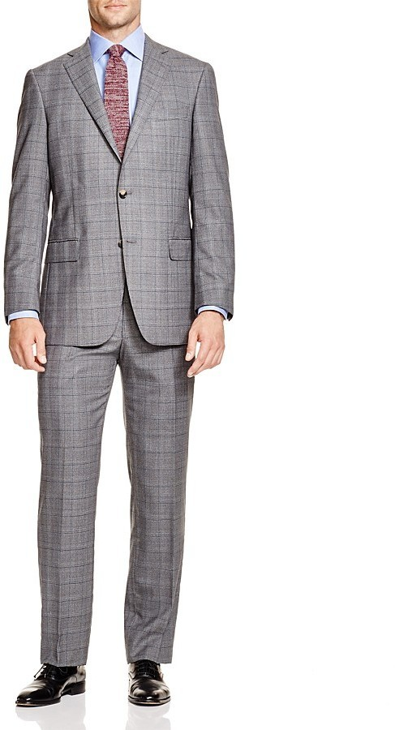
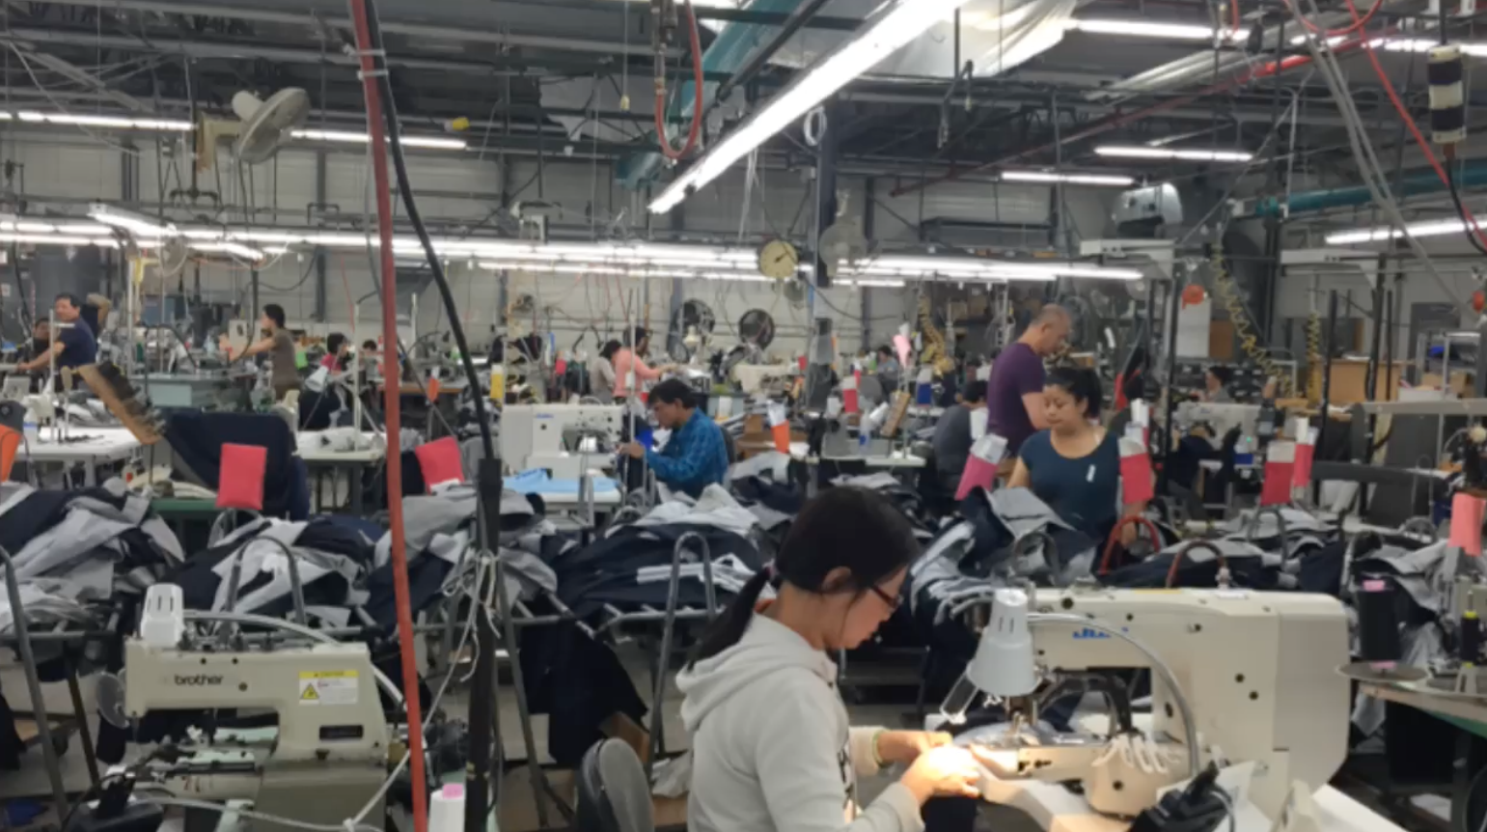
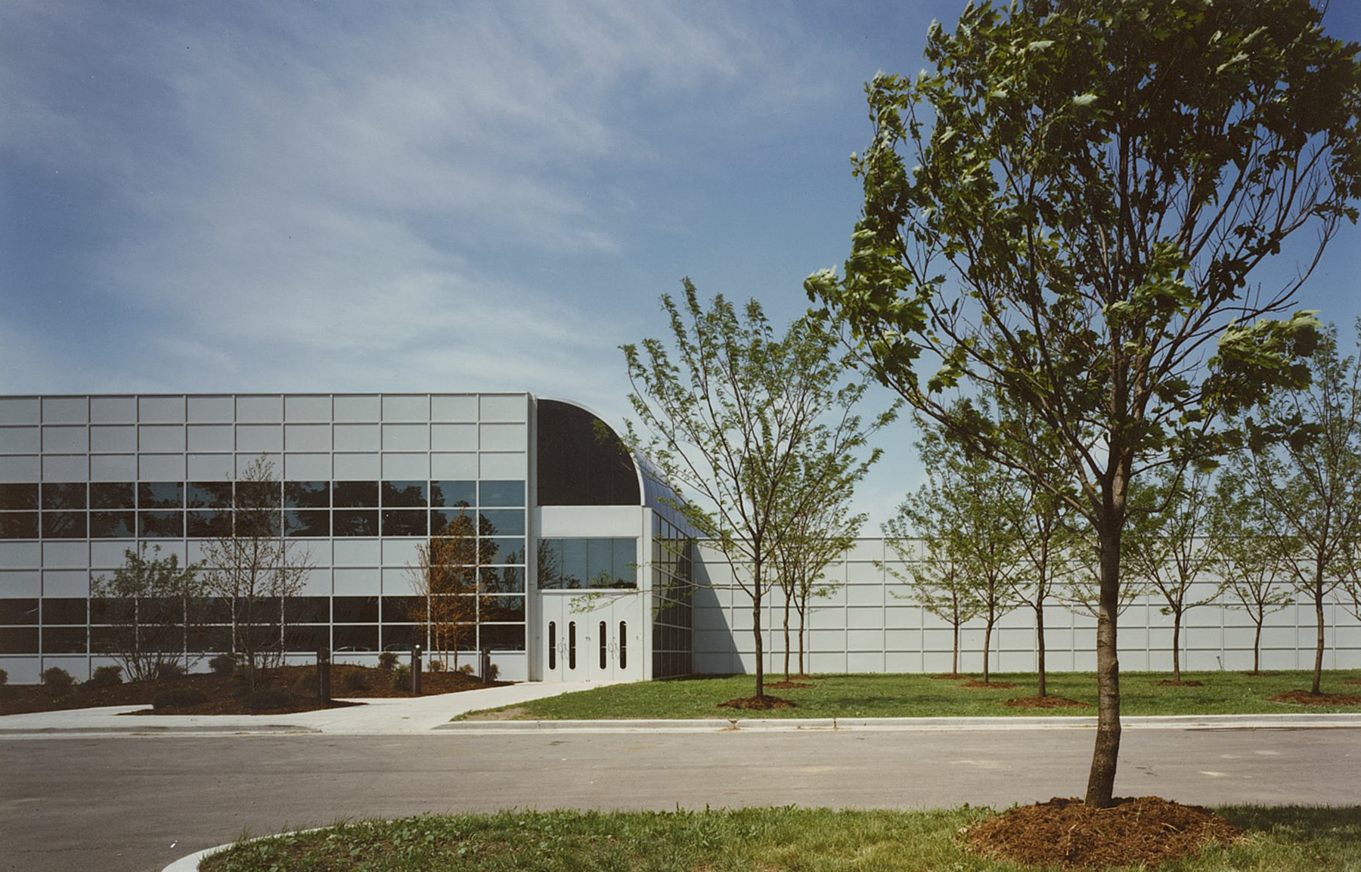
The Employer
Notes:
Founded in 1887, HSM is a men’s apparel clothier headquartered in Chicago, Illinois. The company employs nearly 600 people across its facilities that include manufacturing plants located in both Chicago, Illinois and Cleveland, Ohio. From these two plants, HSM is reported to produce nearly 250,000 jackets and 160,000 suit trousers annually (Grossman, 2017), selling its products in specialty stores, major retailors (e.g., Nordstrom, Bloomingdale’s, and Dillard’s), and direct to consumers. The chief executive officer (CEO) at HSM has been a national leader in the private industry for recognizing the potential for people with autism to contribute to a manufacturing setting.

Slide 12
The Service Provider
MISSION
We are driven to help companies to enjoy the benefits of employing this ready, willing, and able workforce.
Using well-thought-out and proven strategies, we bridge the gap between good intentions and the need to take care of business.
Notes:
Founded in 2009, Exercise Connection was created in an effort to teach exercise to youth with ASD. Research indicates physical exercise interventions reduce stereotypical mannerisms and behaviors, aggression, off-task behavior, and work station elopement among individuals with ASD (Lang et al., 2010). Recognizing the needs of youth transitioning to adulthood, Autism Workforce, a division of Exercise Connection, was created as an employment program for people with ASD. Autism Workforce assists businesses with workplace modifications and training to support employees with ASD and is the first known employment program for people with ASD that incorporates exercise as a core component. Partnering with HSM, Autism Workforce developed a pilot initiative aimed at employing individuals with ASD at the HSM manufacturing plant in Chicago.
Key components next.

Slide 13
https://www.youtube.com/watch?v=7dybeqCZfNo&t=109s
Notes:
https://www.youtube.com/watch?v=7dybeqCZfNo&t=109s
Four young adults with ASD
Ages 20 to 32
Tenure: 1.5 to 3 years
Work an average of 3 days per week for four-hour shifts
Positions (matched by interest and abilities):
Swatch specialist
Expeditor in special orders
Information technology specialist
Stock associate

Slide 14
Key Components
Staff Training
Workplace Preparation
Employee Onboarding
Notes:
Staff training and enlightenment
60-minute staff training
Create an autism-ready guide
Continuous support as jobs progress
Data collection per job
On-going feedback assessment from staff
Workplace preparation
Identify job opportunities
Modify human resource documents
Create autism-ready job descriptions
Added color-coded systems
Create an autism-ready environment
Employee On-boarding:
Autism-Ready interview process
Custom training for each position
Written, visual and video supports
Modified software to assist in work performance

Slide 15
Examples of Workplace Preparation
“Autism Ready”
Job Description
Sets real expectations
Physical requirements
Sensory levels
Structured schedule

Slide 16
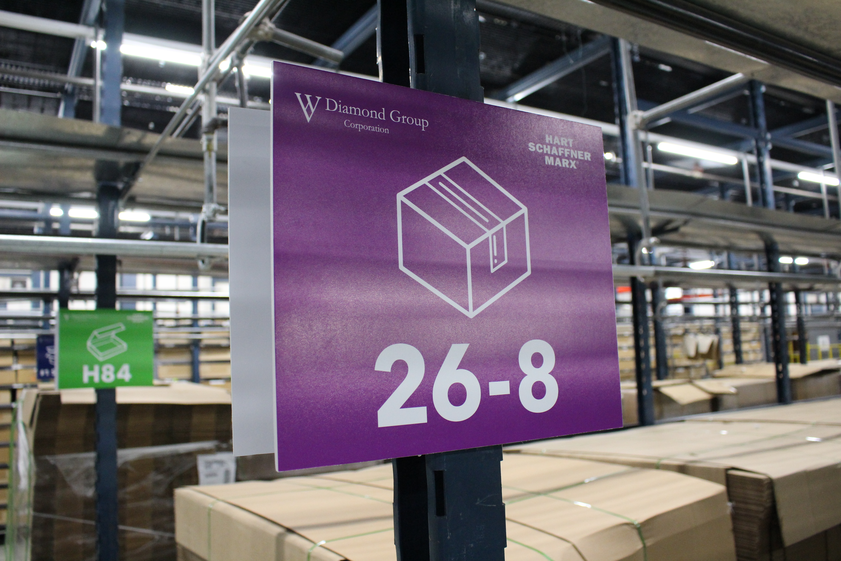
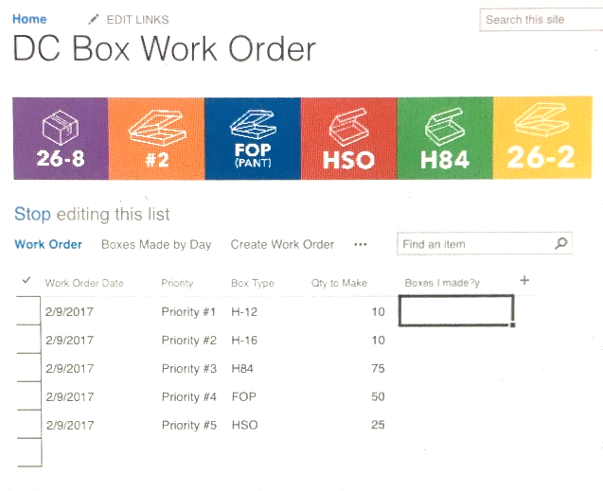
Examples of Workplace Preparation
Color-Coded Systems

Slide 18
Key Components
Staff Training
Workplace Preparation
Employee Onboarding
Notes:
Staff training and enlightenment
60-minute staff training
Create an autism-ready guide
Continuous support as jobs progress
Data collection per job
On-going feedback assessment from staff
Workplace preparation
Identify job opportunities
Modify human resource documents
Create autism-ready job descriptions
Added color-coded systems
Create an autism-ready environment
Employee On-boarding:
Autism-Ready interview process
Custom training for each position
Written, visual and video supports
Modified software to assist in work performance

Slide 19
Case Study Purpose
To understand the perspectives of the employees and leadership at HSM about the autism initiative and characteristics of the business that led to the success of the initiative.
Adds to the evidence of employer practices research in the area of hiring, accommodating, and integrating people with disabilities in the workplace.
Notes:
For this case study, we interviewed the co-workers and managers of the employees with ASD. We also interviewed the executive leadership team. We interviewed 33 team members.

Slide 20
Findings
What did the co-workers and supervisors think?

Slide 21
Domains Shared Across Groups | Management Team Only
Evaluations of Autism Workforce at HSM Influence of autism initiative on HSM and its employees Performance and integration of employees with autism Characteristics of HSM that influenced the success of Autism Workforce | Suggested modifications and future directions of Autism Workforce at HSM

Slide 22
Evaluation of Autism Workforce
We were all nervous because we didn’t understand the autism program. We never had any dealings with autistic individuals…I mean, you see movies about autistic individuals, like they have outbursts and you know they’re sensitive to noises and other things, so we said how are we gonna deal with this? (Supervisor)
I think it was a positive addition to the department. (Co-worker)
Notes:
Evaluations of Autism Workforce – A common narrative from HSM management and staff was of anxiousness and hesitations prior to meeting employees with autism that evolved into highly positive perceptions once the workers were established in the company.

Slide 23
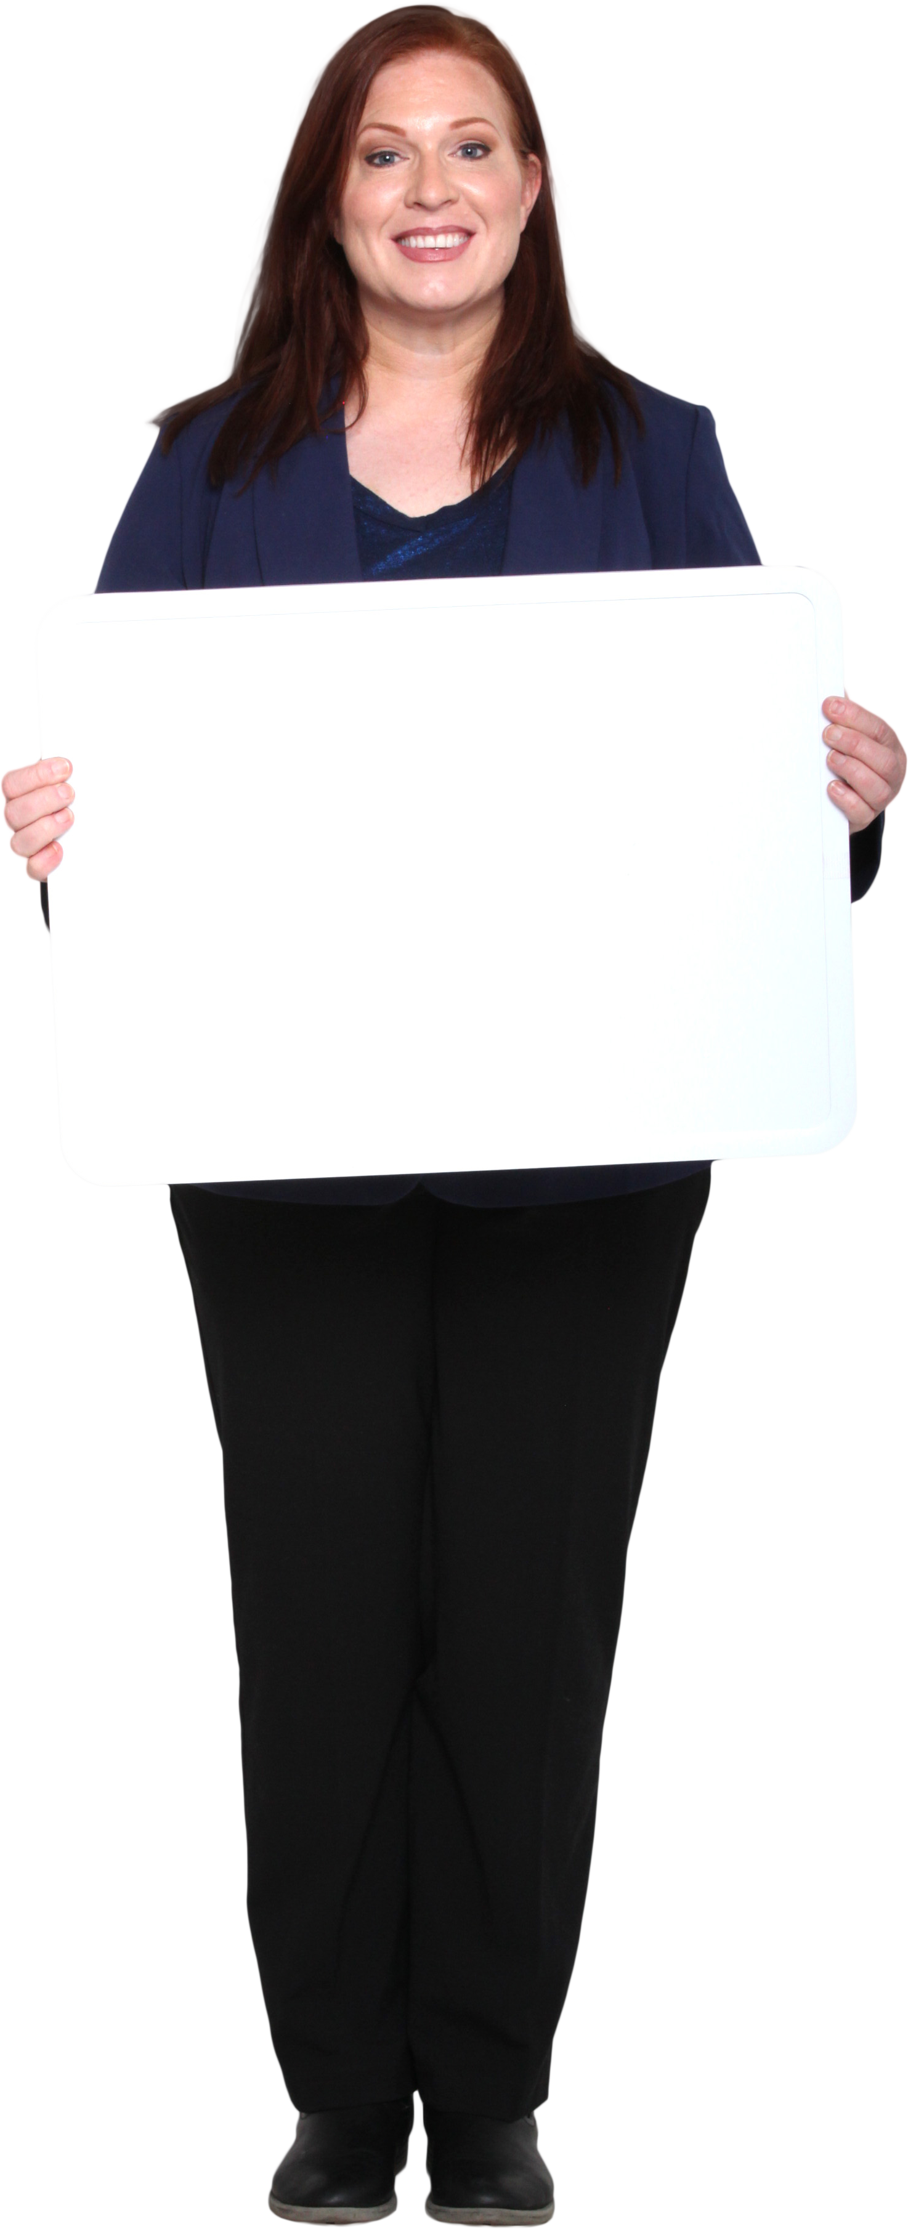
Influence of Employees with Autism
It [the autism initiative] put HSM back on the map. It's not only for clothing, but now HSM is a company that incorporates these workers… we do more than just make clothing. We’re a company that embraces the workforce – you know, different workforces.”(Co-worker)
It just makes it a better work experience overall, you just feel better about what you're doing.”(Supervisor)
Notes:
Influence of Employees with Autism – HSM Management and staff talked extensively about the benefits of the autism initiative. These were categorized into benefits to the company and benefits to the employees.

Slide 24
Influence of Employees with Autism
And it was nice and we scheduled this individual [worker with autism] on specific days that we knew are peak days of the week. And that's how we saw the productivity got a lot smoother. With the pack line we saw that there was less overtime at the end of the day. And we saw that they were pushing more volume out early in the day better than later in the day after five or six o'clock, which was really nice. (Supervisor)
Notes:
Increased productivity was also noted as a benefit by management and co-workers

Slide 25
Performance and Integration
It's just, working with him and talking to him sometimes, it's great. It's just fantastic. We've seen him grown since the time we did hire him ‘til now. I mean, he's really grown into the position. We've given him more responsibilities, which is great, and we look forward to giving him more responsibilities as time goes on. (Supervisor)
Notes:
Performance and integration of employees with autism– Several participants spoke to the quality of work being produced by workers with autism and by their integration into the company.

Slide 26
Key Aspects of the Employer
HSM Management and staff talked extensively about the benefits of the autism initiative. These were categorized into benefits to the company and benefits to the employees.
influence of HSM leadership
diversity of the company
a sense of close bonds among employees
and company altruism
Notes:
M: We knew the background came from [the CEO] whose son has autism and so didn't question the motivation for it or that this was serious and not just somebody's idea that maybe we were going to do or maybe we're not going to do it. So, I think from the start knowing this is a go.
M; “You've got every ethnic background and men, women, you name it, so it's kind of a diverse workforce anyway. I didn't have any concerns about that.”
W: Let me just tell you the history of here. Hart Schaffner Marx - we consider each other as family. We consider ourselves brother, sister, aunts, mother, grandma - whatever. And, when they came in, we brought them in like a family member.
M: … we've tried as best we can to be very, very giving in terms of the amount of our income that we give away to various charitable organizations… We've been giving very, very substantial gifts every year. We do this and a lot of other things… We've been very, very aware of the need to give back into society so what [the CEO] proposed made perfectly good sense.

Slide 27
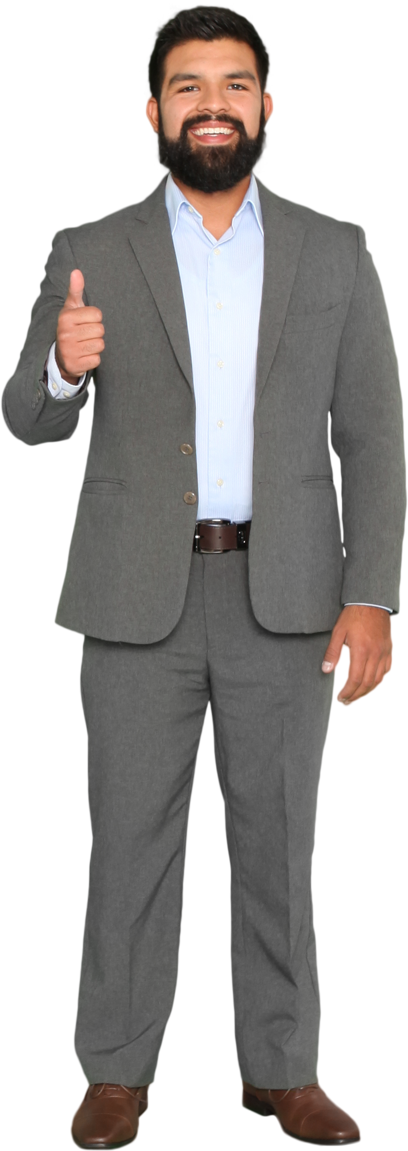
Suggestions and Future Directions
Most suggestions centered around increased length, type, or intensity of training on working with employees with autism
Future directions focused on increasing the number of workers with autism and on fading of Autism Workforce services to a more as needed basis

Slide 28
Summary
Despite minor areas for improvement, the response was highly positive among HSM management and staff
There appears to be multiple internal and external benefits of this autism initiative. Greater exploration of these benefits may give further incentive for companies to diversify their workforce with employees who have autism and other types of disabilities.

Slide 29
Implications for Practice

Slide 30
Three Key Points
1. There was a highly positive response regarding the autism initiative. As with other initiatives for hiring diverse populations, any initial reservations about hiring people with Autism appeared to evolve into a willingness to expand hiring of this population in the future (Morgan & Alexander, 2005).
Notes:
The study yielded three key points that can be taken away from this present research.
Case study results indicate there was a highly positive response regarding the autism initiative. As with other initiatives for hiring diverse populations, any initial reservations about hiring people with ASD appeared to evolve into a willingness to expand hiring of this population in the future (Morgan & Alexander, 2005).
Management, supervisors, and co-workers all described employees with ASD as being integrated not only within job related tasks but also in informal social relationships. This case study highlighted each of these factors in the HSM work setting, which may help to explain the unity that was developed through the autism initiative described here.
The autism initiative was created with the intention of being a model for other for-profit businesses. Building upon the strengths identified through this investigation future businesses can strive to create an inclusive and successful work environment for individuals with ASD and other disabilities.

Slide 31
Three Key Points
2. Management, supervisors, and co-workers all described employees with ASD as being integrated not only within job related tasks but also in informal social relationships. This case study highlighted each of these factors in the HSM work setting, which may help to explain the unity that was developed through the autism initiative described here.
Notes:
The study yielded three key points that can be taken away from this present research.
Case study results indicate there was a highly positive response regarding the autism initiative. As with other initiatives for hiring diverse populations, any initial reservations about hiring people with ASD appeared to evolve into a willingness to expand hiring of this population in the future (Morgan & Alexander, 2005).
Management, supervisors, and co-workers all described employees with ASD as being integrated not only within job related tasks but also in informal social relationships. This case study highlighted each of these factors in the HSM work setting, which may help to explain the unity that was developed through the autism initiative described here.
The autism initiative was created with the intention of being a model for other for-profit businesses. Building upon the strengths identified through this investigation future businesses can strive to create an inclusive and successful work environment for individuals with ASD and other disabilities.

Slide 32
Three Key Points
3. The autism initiative was created with the intention of being a model for other for-profit businesses. Building upon the strengths identified through this investigation future businesses can strive to create an inclusive and successful work environment for individuals with Autism and other disabilities.
Notes:
The study yielded three key points that can be taken away from this present research.
Case study results indicate there was a highly positive response regarding the autism initiative. As with other initiatives for hiring diverse populations, any initial reservations about hiring people with ASD appeared to evolve into a willingness to expand hiring of this population in the future (Morgan & Alexander, 2005).
Management, supervisors, and co-workers all described employees with ASD as being integrated not only within job related tasks but also in informal social relationships. This case study highlighted each of these factors in the HSM work setting, which may help to explain the unity that was developed through the autism initiative described here.
The autism initiative was created with the intention of being a model for other for-profit businesses. Building upon the strengths identified through this investigation future businesses can strive to create an inclusive and successful work environment for individuals with ASD and other disabilities.

Slide 33
Implications for Rehabilitation Practice
This initial exploration suggests that the collaboration between HSM and Autism Workforce may prove a meaningful prototype for other companies interested in employing people with ASD.
Rehabilitation professionals may promote this prototype model while engaging employers.
Positive responses toward the autism initiative were also attributed to the autism training provided to employees at HSM.
This result highlights the need for rehabilitation professionals to assist in the training of other employees in order to facilitate an environment of adaptability, integration, and assimilation.
Notes:
Specific characteristics of HSM that were noted to contribute to the success of the autism initiative included HSM leadership, diversity of the company, close bonds among employees, and company altruism. The C-Suite at HSM made clear that this initiative is good business rather than charity. This initial exploration suggests that the collaboration between HSM and Autism Workforce may prove a meaningful prototype for other companies interested in employing people with ASD. Rehabilitation professionals may promote this prototype model while engaging employers.
Further, positive responses toward the autism initiative were also attributed to the autism training provided to employees at HSM. This result highlights the need for rehabilitation professionals to assist in the training of other employees in order to facilitate an environment of adaptability, integration, and assimilation.

Slide 34
Accommodation Resources
Autism Spectrum (askjan.org)
AskEARN | Neurodiversity in the Workplace
Autism and the Workplace: A Guide for Employers | Organization for Autism Research (researchautism.org)
OCALI | Employing Individuals with Autism
Notes:
Here are some resources for employers, autism support professionals or caregivers, and Autistic self-advocates.

Slide 35
Questions?

Slide 36
Reference
Autism in the workforce: A case study | Journal of Management & Organization | Cambridge Core
Grenawalt, T. A., Brinck, E. A., Friefeld Kesselmayer, R., Phillips, B. N., Geslak, D., Strauser, Chan, F., & Tansey, T. N. (2020). Autism in the workforce: A case study. Journal of Management & Organization, 1-16. DOI: 10.1017/jmo.2020.15

